Slide 1
ENSE 374, Milestone 1
Space Minds
Anupras Burokas, Ahras Ali, Jack Zhao
Wednesday, Oct. 2

Slide 2
Spaceminds
Ahras, Jack, and Anupras
Our GitHub URL is : https://github.com/374team3

Slide 3
Elevator pitch
Our Team’s Golden Circle:
Why: Space traveling is no longer a fantasy but our living reality and with the right tools anyone can aspire the once unimaginable.
How: We are building an imitation console that educates and inspires young minds about the technological advances of space exploration.
What: We are using J-grade mahogany lumber with fiberglass panels painted with a premium gloss finish; satisfying mechanical buttons with toggle switches that will truly immerse you into the experience of operating in NASA’s mission control center.

Slide 4
Initial system & functional requirements
We are designing a space console for youth and young adults to be able to experience the operations based of NASA’s mission control center in Houston, Texas.
Our vision is to inspire young minds to advance their understanding of deep space communications between the spacecraft and HQ.
We are trying to fill the gap of space interest for the millennial age bracket.
The rationale behind our group project is that this is a good balance between hardware and software as it consists of building and programming.
Our Envisioned stakeholders include NASA, SpaceX, Blue Origin, CSA(Canadian Space Agency), Education Canada, and Hasbro.
Our major constraints is budget and part gathering; buying mainly from amazon and the shipping time may push our time-line back. Another would be the inputs and outputs of a single arduino as we have limited button-to-pin ratio.

Slide 5
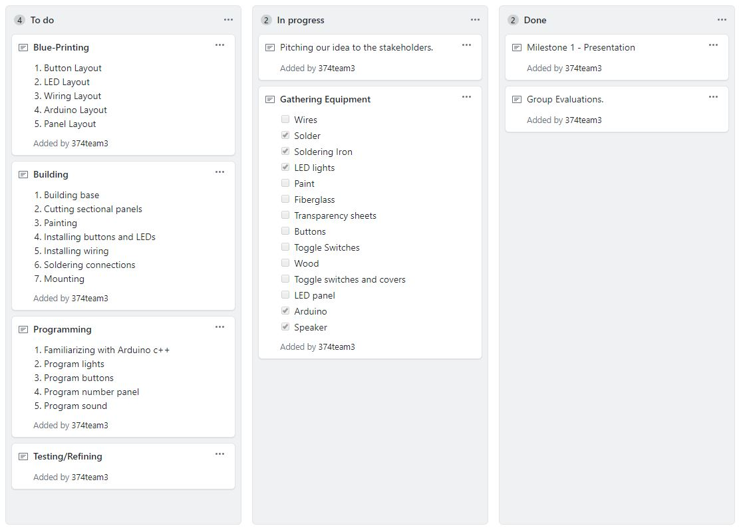
Kanban
https://github.com/users/374team3/projects/1

Slide 6
Group reflection
How did you feel about this milestone? What did you like about it? What did you dislike?
This milestone was pretty interesting and we love the flexibility that we had in choosing what to do.
What did you learn about yourself as you collaborated and worked through this milestone?
Try to start things earlier if possible
How will you use what you have learned going forward?
For the future we will try to complete small tasks frequently instead of working on everything in a short time span.
What “stuff & things” related to this milestone would you want help with?
Spare parts and the ENEL laboratory for soldering.

Slide 7
Questions

